Slide 1


BotNet Attack And Detection
Team – 4
Harsha → 12010324010
Siva→ 122010324014
Saleem→ 122010324018
Nikhita→122010324021
DEPARTMENT OF COMPUTER SCIENCE AND ENGINEERING
GITAM
(Deemed to be University)
VISAKHAPATNAM
Project Guide:
K. Sandeep Varma
Assistant Professor, Dept. of CSE, GITAM (Deemed to be University), Visakhapatnam.

Slide 3
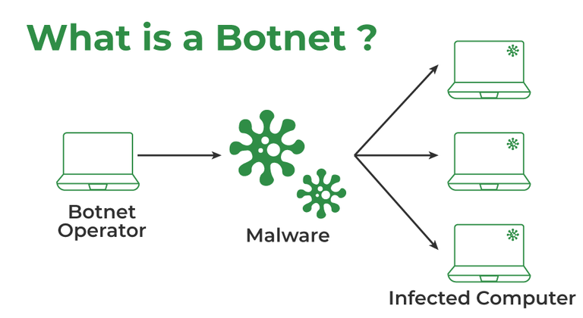
What is BotNet?.......
A botnet refers to a group of computers which have been infected by malware and have come under the control of a malicious actor.
The term botnet is a portmanteau from the words robot and network and each infected device is called a bot.

Slide 4
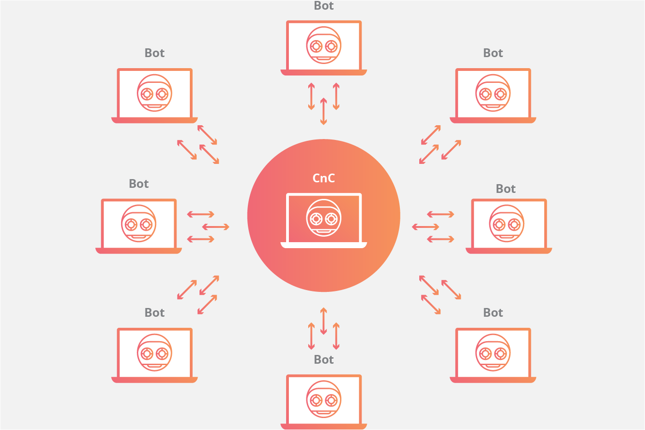
BotNets are mainly used for?....
Botnets are commonly used to send spam emails, engage in click fraud campaigns and generate malicious traffic for distributed denial-of-service (DDoS) attacks.

Slide 5

How Does it Work?
The working of the Botnet can be defined as either you writing code to build software or using it from the available (Leaked) botnet like ZEUS Botnet(king of all botnet), Mirai botnet, BASHLITE, etc.
Then finding the vulnerable system where you can install this software through some means like social engineering (e.g Phishing) soon that system becomes a part of a bot army.
Those who control it are called the botmaster which communicates its bot army using a command and control channel.

Slide 6
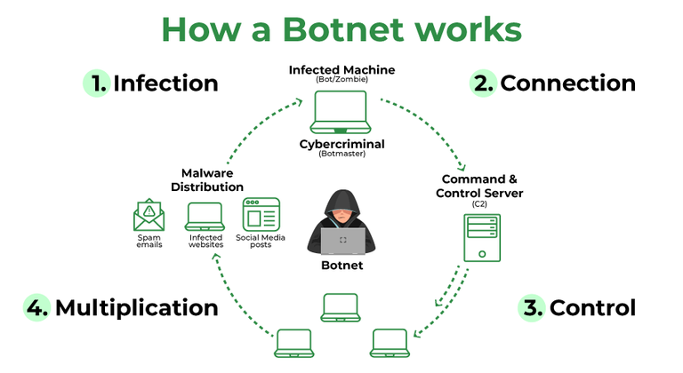

Slide 7
Types of Botnet Attacks
Phishing: Botnets help in distributing malware and suspicious activities via Phishing emails. These include a multiple number of bots and the whole process is automated and it is difficult to shut down.
Distributed Denial-of-Service(DDoS) Attack: DDoS Attack is a type of attack performed by the Botnets in which multiple requests are sent that leads to the crash of a particular application or server. DDoS Attacks by Network Layer use SYN Floods, UDP Floods, etc to grasp the target’s bandwidth and let them protect from being attacked.
Spambots: Spambots are a type of Botnet Attack, where they take emails from websites, guestbooks, or anywhere an email id is required to log in. This section covers more than 80 percent of spam.
Targeted Intrusion: This is one of the most dangerous attacks as they attack the most valuable thing or data, valuable property, etc.

Slide 8
Bulit Your Own BotNet

Slide 9
Objectives: Comprehensive analysis of botnet attacks and development of ML-based detection system:
This part of the slide outlines the main objectives of the project. First, it aims to conduct a comprehensive analysis of botnet attacks. This includes understanding the various types of botnet attacks, their characteristics, propagation methods, and impacts on network security. By conducting this analysis, the project aims to gain deeper insights into the nature of botnet threats, which will inform the development of effective defense mechanisms.
Secondly, the project aims to develop a machine learning-based detection system for botnet attacks. Leveraging machine learning algorithms, the system will be designed to analyze network traffic patterns and behaviors to identify potential botnet activities. By developing this detection system, the project aims to provide proactive defense against botnet attacks, helping to mitigate their impact on network security.

Slide 10
Overall, this slide highlights the primary objectives of the project: conducting a comprehensive analysis of botnet attacks and developing a machine learning-based detection system to enhance network security against evolving threats. It underscores the project's focus on proactive defense mechanisms and its contribution to strengthening cybersecurity practices

Slide 11
machine learning algorithms
Supervised learning algorithms, such as support vector machines and random forests, are trained on labeled datasets to recognize known patterns of malicious behavior.
Unsupervised learning algorithms, such as clustering and anomaly detection, can detect novel threats or anomalies in network traffic without the need for labeled data.

Slide 12
Motivation
Botnets signifies one of the most severe cybersecurity threats faced by everyone today.
Botnets have been used as the main path in carrying many cybercrimes reported in the recent news.
The Internet traffic consisted of up to 80% of botnets traffic related to spam e-mails originating from known botnets such as Grum, Cutwail and Rustock.
Currently, a large scale of botnets can be more than one million PCs, launching cyber attacks.
The FBI in 2023 reported that 10 international hackers were arrested for using botnets to steal more than $850 million through a group of compromised computers; they use the personal financial information of the people to steal such amount.

Slide 13
Table of Content
1.Introduction
2. Types of attack
3. Most wanted bots
4. Life cycle of bots
5. Botnet topologies
BotNet Creation
Detection using Machine Learning Algorithms
Predecting The Result Using

